Slide 1
ONT sequencing and downstream process
Programs or tools used:
MinKnow
Guppy or Dorado
Nanoplot + fastqc(not necessary)
Flye + canu
Medaka
pLannotate
Minimap2
Samtools
Bcftools

Slide 2
Config files for all tools and input/ouputs
WPS input lib table:
determine genome size for flye based on Plasmid size (bp)** in the Order Sheet
and flye requires it as 11k, 3.5k, 22k so if needed I will write it like that in the excel file
Flye
minimap

Slide 3
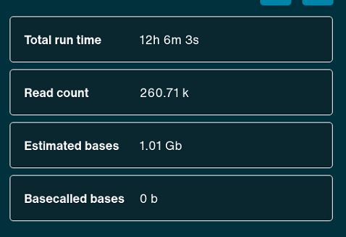
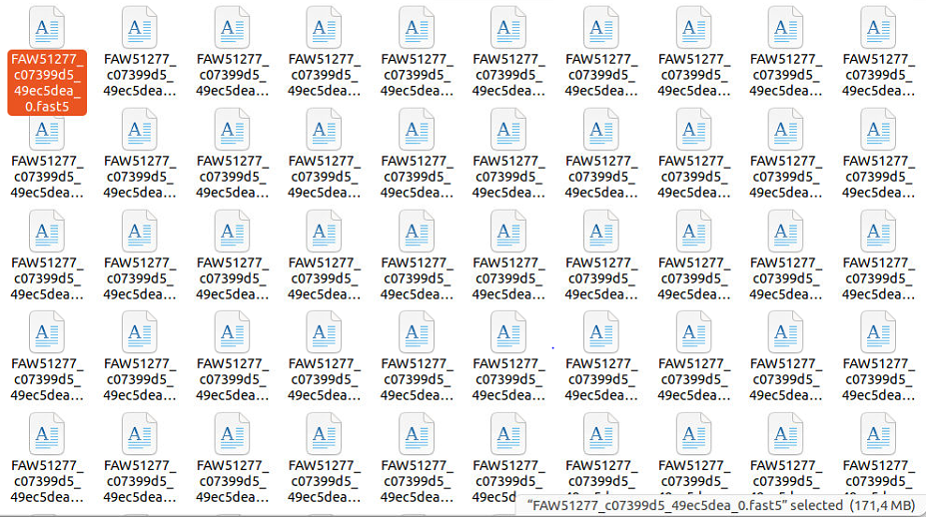
Raw data obtained from MinKnow software used for sequencing, output as FAST5 or POD files (technical support from ONT mentioned that the POD will be the mainly used in close future)

Slide 4
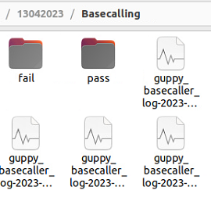
Basecalling performed in Guppy using GPU with configuration 260bps_hac and with a minimum Qscore of 10 (this is set by the sequencing configuration chosen in MinKnow and high accuracy, we could also choose super high accuracy but for some reason it had an error when tried). Basecaller called DORADO will replace Guppy using the POD files. The output should be compressed fastq.gz files.

Slide 5
Location of Guppy installation: /opt/ont/guppy/
data/
lib/
bin/
Testing cmd: guppy_basecaller -i /data/Nanopore/MinIOn_01/20230413/20230413_1635_MN42632_FAW51277_c07399d5/fast5 -s /data/Nanopore/MinIOn_01/20230413/20230413_1635_MN42632_FAW51277_c07399d5/basecall_output -c /opt/ont/guppy/data/dna_r10.4.1_e8.2_260bps_hac.cfg -x auto -r --detect_adapter --detect_barcodes --detect_mid_strand_adapter --do_read_splitting --trim_adapters --min_qscore 10 --compress_fastq

Slide 6
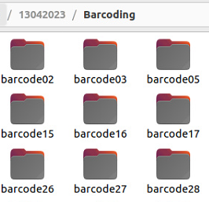
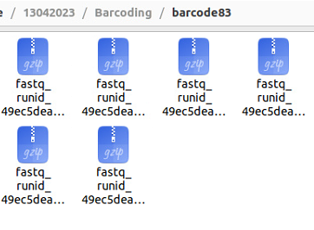

After basecalling I did demultiplexing also in Guppy but it can be done in the same step, with trimming of both adapters and barcodes. This results in a folder with all the barcodes as subfolders and fastq.gz files.
The fastq.gz files will be the input for further processing.
I added a step here to concatenate all the fastq files per barcode, in this way we can include the compressed raw data to send to the customers.
cat output/*.fastq >all.fastq
fastqc

Slide 7
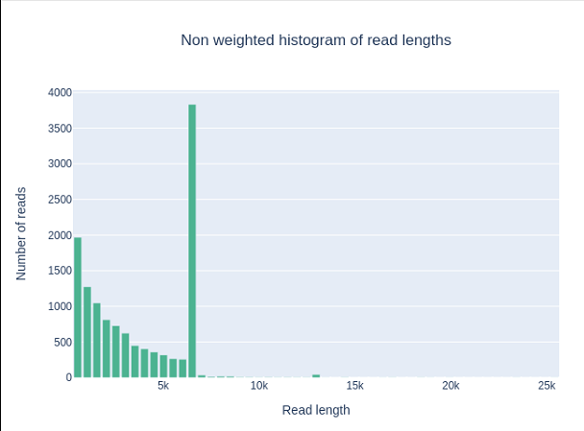
Nanoplot is used to generate a set of plots from which we just need one as result to send to the customer.
For all pass and failed
Per barcode

Slide 8

Flye is the tool that showed fast processing for the de novo assembly step with a fasta file as output. And Medaka used for a ‘polishing’ step with another fasta file as the final consensus output that will be send to the customer.
The ‘asm-coverage’ option from the Flye assembler subsamples the longest reads, it was set to 50, but sometimes also with 10 or 30. Also, I noticed that if one of the barcodes has several fastq files, processing all of them generates a double sized plasmid, and by processing just one fastq file we got enough information for assembling the plasmid.

Slide 9
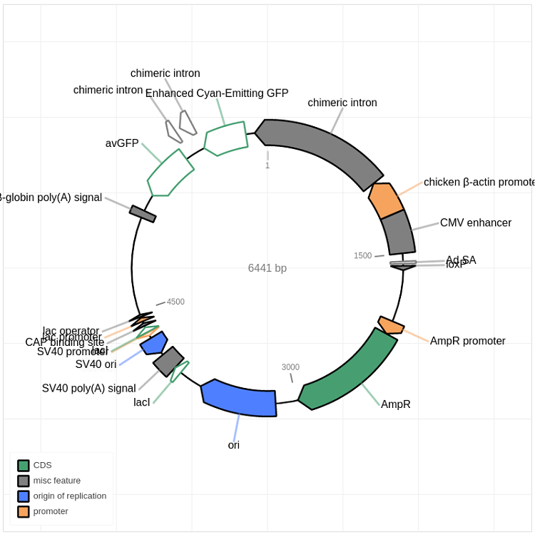

With the fasta file from the previous step we can then generate an annotated map of the plasmid using pLannotate, this gives us two output files .html and .gbk that will be used as final results for the customer.

Slide 10
The last file(s) we need to generate as result for our customers is a counting of the different bases found in each position. As per my research it could be the process known as Variant Calling but we just need to create a csv file that can show some of the data and a fastq file. See example files got from our competitor.
My approach has been using minimap2, samtools, and bcftools for doing such file and extracting some of the columns. However, I don’t know exactly every command to use for creating the file and I noticed this step takes longer time per sample. The steps that I know till now are: mapping of the consensus obtained and all the reads of the barcode, sorting the created bam file, indexing it, and then doing a pileup, after the pileup is finished, we can extract some information.
minimap2 -a ref.fa query.fq > alignment.sam

Slide 11
For the last part I would like to add the commands for creating a folder with the name of the sample given by the customer and copy the files that we will send to the customer. With the possibility of already renaming them with the sample name too and send this folder as final result.

